Slide 1

Welcome
to the
Multivrse
CS377E | Spring 2019
Nathan D., Glenn D., Joyce H., Angelica W.

Slide 2





MultiVRse
A VR world that immerses a user in realistic, culturally aware, scenarios with AI-powered language support tools that evoke nuanced and goal-oriented language learning experiences.
Notes:
A VR world that immerses a user in realistic, culturally aware, scenarios with AI-powered language support tools that evoke nuanced and goal-oriented learning experiences

Slide 3


Experiment design
HUMAN V.S. AI
ON THE OTHER SIDE
(In both conditions, users are allowed to use any technologies, such as their phone or dictionary, they would normally use to help them communicate)
Notes:
Condition 1: user + tell them it’s human
Condition 2: user + tell them it’s AI
In both conditions, users are allowed to use any technologies, such as their phone or dictionary, they would normally use to help them communicate.

Slide 4

Research questions => Tasks
When engaging with AI, would users feel more engaged or anxious?
Would they feel less embarrassed about making mistakes?
Would they try harder or less hard to communicate well (operationalized by usage of language support tools)?
Notes:
Study:
Research question statement
Condition 1: user + tell them it’s human
Condition 2: user + tell them it’s AI
We want to compare two conditions and see if the perception of the other person changes learners interact with the system

Slide 5
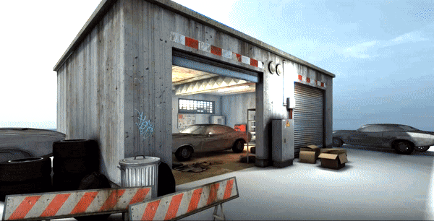
WHy this Scenario
✓ Real life event
✓ Semi-open ended
✓ Clear goals
✓ Involves non-trivial, context specific vocabulary
Multivrse
A visit to the mechanic
Scenario #1
START
Notes:
Real life, somewhat open ended
Clear goals and can involve no trivial vocabulary , things that you won’t come across in an everyday class

Slide 6



Experiment design
[Behind the scenes]
Instructions
(AI or not AI)
Situational Prompt Video
Goal-oriented conversation in VR
WoZ script
Notes:
Our proposed experiment design.
Behind the scenes, we use Wizard of Oz and give responses using a script we developed around a conversation between someone who wants to get his/her car fixed and a mechanic.
We plan to have design the experience to be less than 10 minutes and will analyze the data qualitatively.

Slide 7

Experiment [RE]design #2
Insight: Videos left users to make too many assumptions
[Before]
[After]
Situational Prompt Video
Detailed written instructions
Notes:
Our proposed experiment design.
Behind the scenes, we use Wizard of Oz and give responses using a script we developed around a conversation between someone who wants to get his/her car fixed and a mechanic.
We plan to have design the experience to be less than 10 minutes and will analyze the data qualitatively.

Slide 8

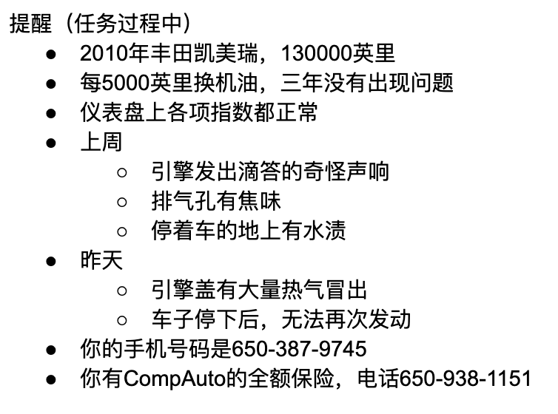
Interface redesign #1: Instructions
Background information for users in native language (Chinese)
Key points to refer to during the interaction
Description of problems with their car

Slide 9
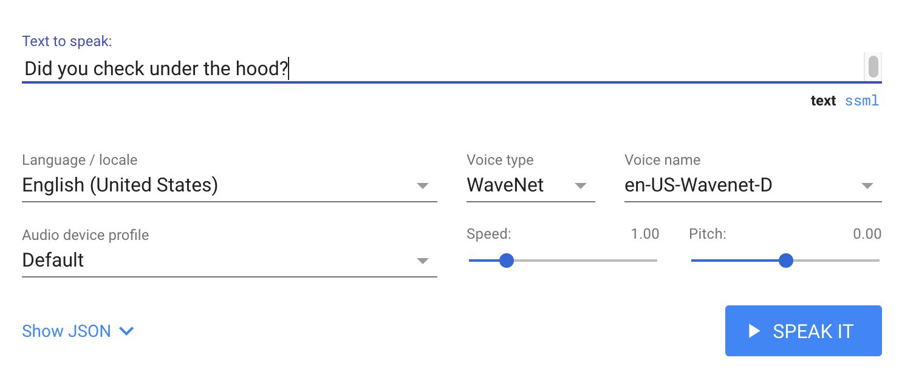
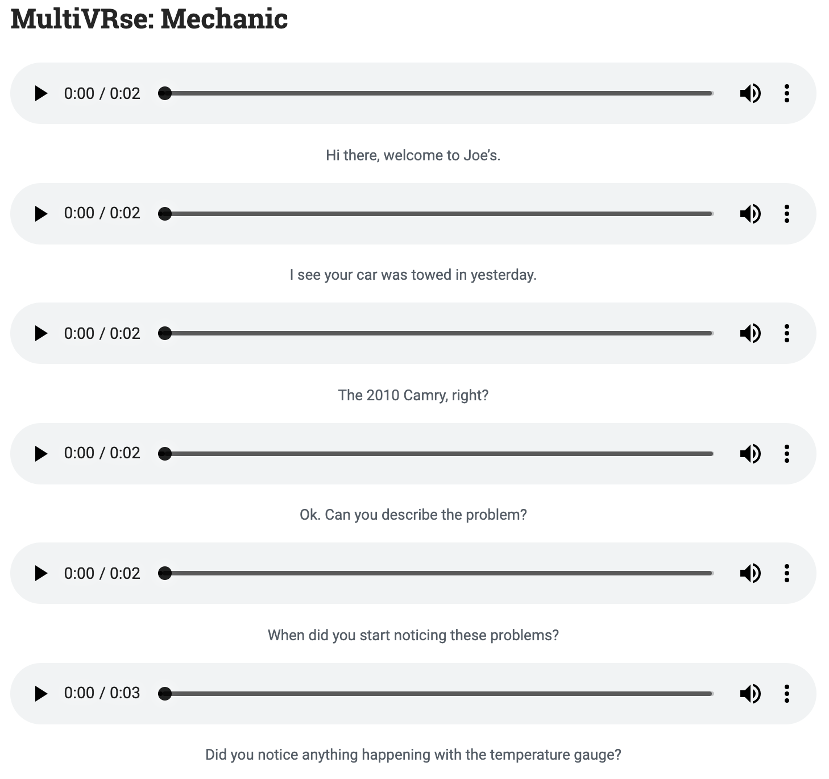
Interface redesign #1: WOZ Side
Pre Recorded phrases on soundboard
Real-time phrases
Using AI, to WOZ AI
With Google Cloud Text-To-Speech (WaveNet)

Slide 10
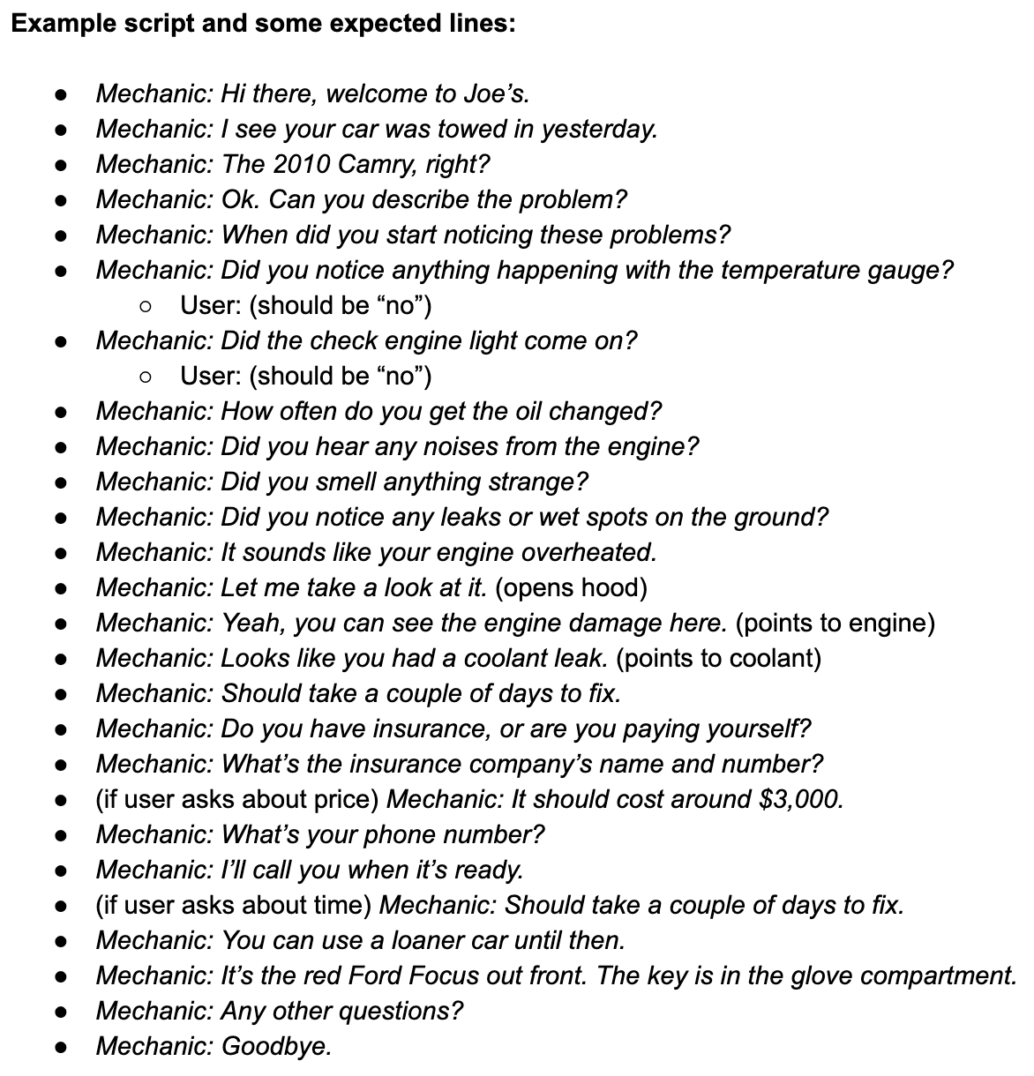
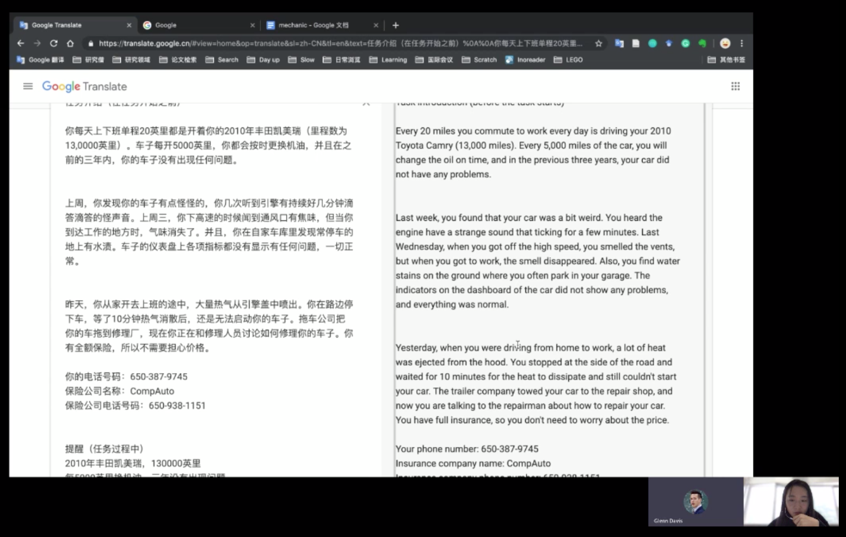
Interface redesign #1: Revised Script

Slide 11
Usability study
Study goals:
Learn what kind of language support users need.
Test the script and situation for believability, understanding.
Procedure:
Send background information in native language (Chinese) to user, describing problems with their car.
Talk to an “AI mechanic” (Wizard of Oz) in order to get the car fixed.
Record user’s screen in order to examine which language support tools are used.
5 total participants: 4 Native Chinese speakers, with limited proficiency in English and 1 Native English speaker with limited French proficiency (Proxy for expats/immigrants, A2-B1 = high beginner to low intermediate)
Notes:
Proxy for expats/immigrants with limited language proficiency who nonetheless need to be able to do important real-life tasks

Slide 12

Data Collection
Engagement with the task
How users prepare for the task
Time spent on the task
Usage of language support tools
Tools they use
Level of engagement/reliance
Engagement with the “AI”
# times participant ask for repetition and clarification
Attitudes (Post-survey)
Foreign Language Anxiety Scale
Engagement with AI
Notes:
What data to collect to answer our research questions:
what and how they are preparing for the conversation
# times they use language supports
translator
dictionary
Maybe google translate speech
Time spent on the task
# times participant ask for repetition and clarification
Post-intervention survey - foreign language anxiety scale
Other observations - qualitative data
When engaging with AI, would users feel more engaged or anxious?
Would they feel less embarrassed about making mistakes?
Would they try harder or less hard to communicate well (operationalized by usage of language support tools)?

Slide 13
Results

Slide 14
Insights and Results
Usability study
100% of users spent time to prepare before the task/conversation (averaged between 1- 6 minutes)
Participants rely on nonverbal cues of understanding to know how they are doing
100% used language support tools, direct google translation, and e-dictionary (but used it for direct word translation)
Participant asked for feedback on his English performance on the task
Notes:
Feels more comfortable to keep asking “pardon” when it’s a machine on the other side
All spent time to prepare before the task/conversation
All used language support tools, direct google translation, and e-dictionary (but used it for direct word translation)

Slide 15

Experiment [RE]design #2
Key Insight: Not only is goal orientation important for motivation, it is important for ensuring productive conversation
[Before]
[After]
Goal-oriented conversation in VR
Multiple goals for a single conversation in VR

Slide 16
Experiment [RE]design #2
Key Insight: When saying “Pardon me,” or asking the agent to repeat themselves, users expect things to be said differently, or broken down into more simple language
[Before]
[After]
Single script
Skill level adaptive script
Notes:
Our proposed experiment design.
Behind the scenes, we use Wizard of Oz and give responses using a script we developed around a conversation between someone who wants to get his/her car fixed and a mechanic.
We plan to have design the experience to be less than 10 minutes and will analyze the data qualitatively.

Slide 17

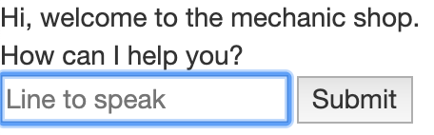
Interface [RE]design #2: VR World
User view (Oculus Go VR)
Wizard View (Mechanic speech)
Oculus Go app (Built in Unity)
Freely view the mechanic’s garage in VR
Receive real-time text-to-speech typed into a Python/Flask server
Language support tools through users’ own phones
Simple chat Website for WOZ operator improves speed

Slide 18
Interface [RE]design #2: VR World
Next steps to implement:
Limited language support tools
- Suggested phrases Users own notes?
- More adaptive script options
Basic non-verbal communication
- “Pointing” at different objects (car engine, radiator, etc.) in the world to draw attention

Slide 19
Thanks!
[in advance, for your feedback]

Slide 20
appendix

Slide 21
Insight -> revision:
No one actually uses dictionaries, they just look up the translation -> instead of a dictionary, have simple word level translation available
When saying “Pardon” or asking “what did you say,” users expect things to be said differently, or broken down
Sometimes when people dont understand they just say “OK”
[Study specific] Some participants copied all the instructions into english as a hack, we started giving them pictures of the instructions
Making it more realistic (Sometimes doesn’t understand… be more strict on what you accept as a correct)
Notes:
Feels more comfortable to keep asking “pardon” when it’s a machine on the other side
All spent time to prepare before the task/conversation
All used language support tools, direct google translation, and e-dictionary (but used it for direct word translation)
One participant asked for feedback on his English performance on the task

Slide 22
Our Mission is...
To expose language learners to nuanced practice environments through an immersive virtual cultural language experience.
Notes:
To Expose language learners to Realistic Practice Environments through an immersive virtual cultural language experience.

Slide 23
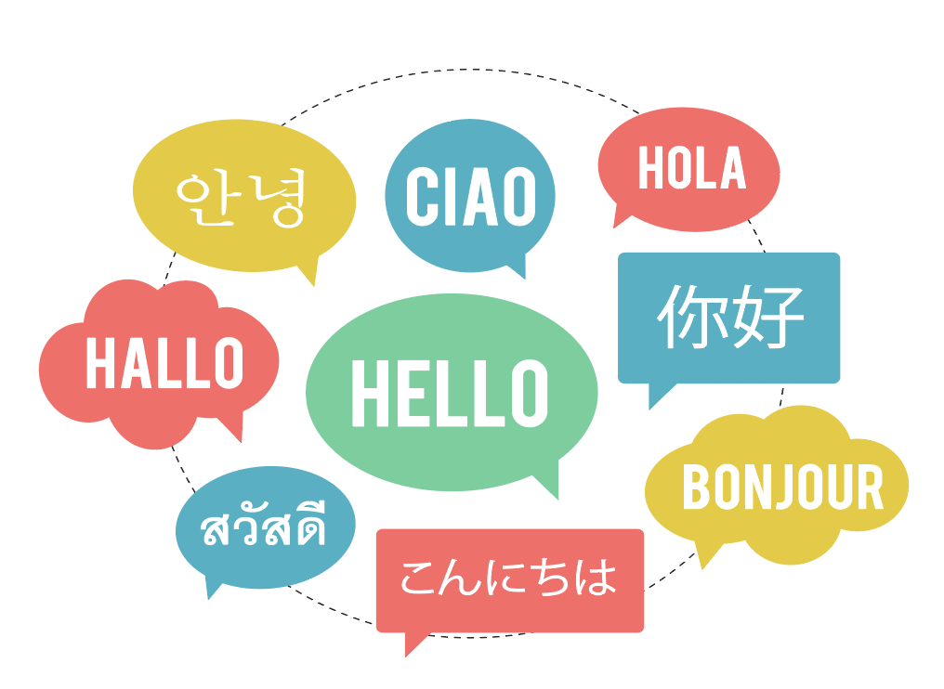
Problems
The natural goal for learning a new language is connection and communication, but traditional language learning methods focus on the means to an end, and not the end goal itself.
Practicing with traditional methods (i.e. classes and apps) leaves users underprepared for real-world interactions, which leads to embarrassment and miscommunication.
Notes:
The focus on the process of speaking well and not communicating well might be associated with the fear of embarrassment and making mistakes.
practicing with traditional methods (i.e. classes and apps) leaves users underprepared for real-world interactions and over-fixated on the perfect use of language instead of communication.

Slide 24
But.... assuming we can build MultiVRse , there are some unanswered questions...
Notes:
Turing this solution into a research questions
Assuming we could build this, there are some unanswered questions about the AI we’re about to build

Slide 25
Solutions or questions?
Would users feel more engaged or anxious?
Do people want to engage with AI?
Would they feel less embarrassed about making mistakes?
Would they try harder or less hard to communicate well?
Notes:
Among them, the questions we’re interested in learning are
Research questions:
how much time they would engage with the dictionary/tech (i.e. language support)
How do they feel about engagement & anxiety
Do they use different languages
Attitude differences and changes - willingness to make mistakes
If the learning experiences are different

Slide 26
Major changes
Designing a Solution -> Designing experiences to test Research Questions
Task -> Experimental Design
Task Flows -> Experiment procedures
Notes:
That said, there are some major changes in our approach to this solution
Instead of building a product, we want to focus on designing experiences to test Research Questions that may inform future design
Focusing on one specific simulation instead of trying to design a language learning gameplay experience
Build the VR experience on Unity

Slide 27
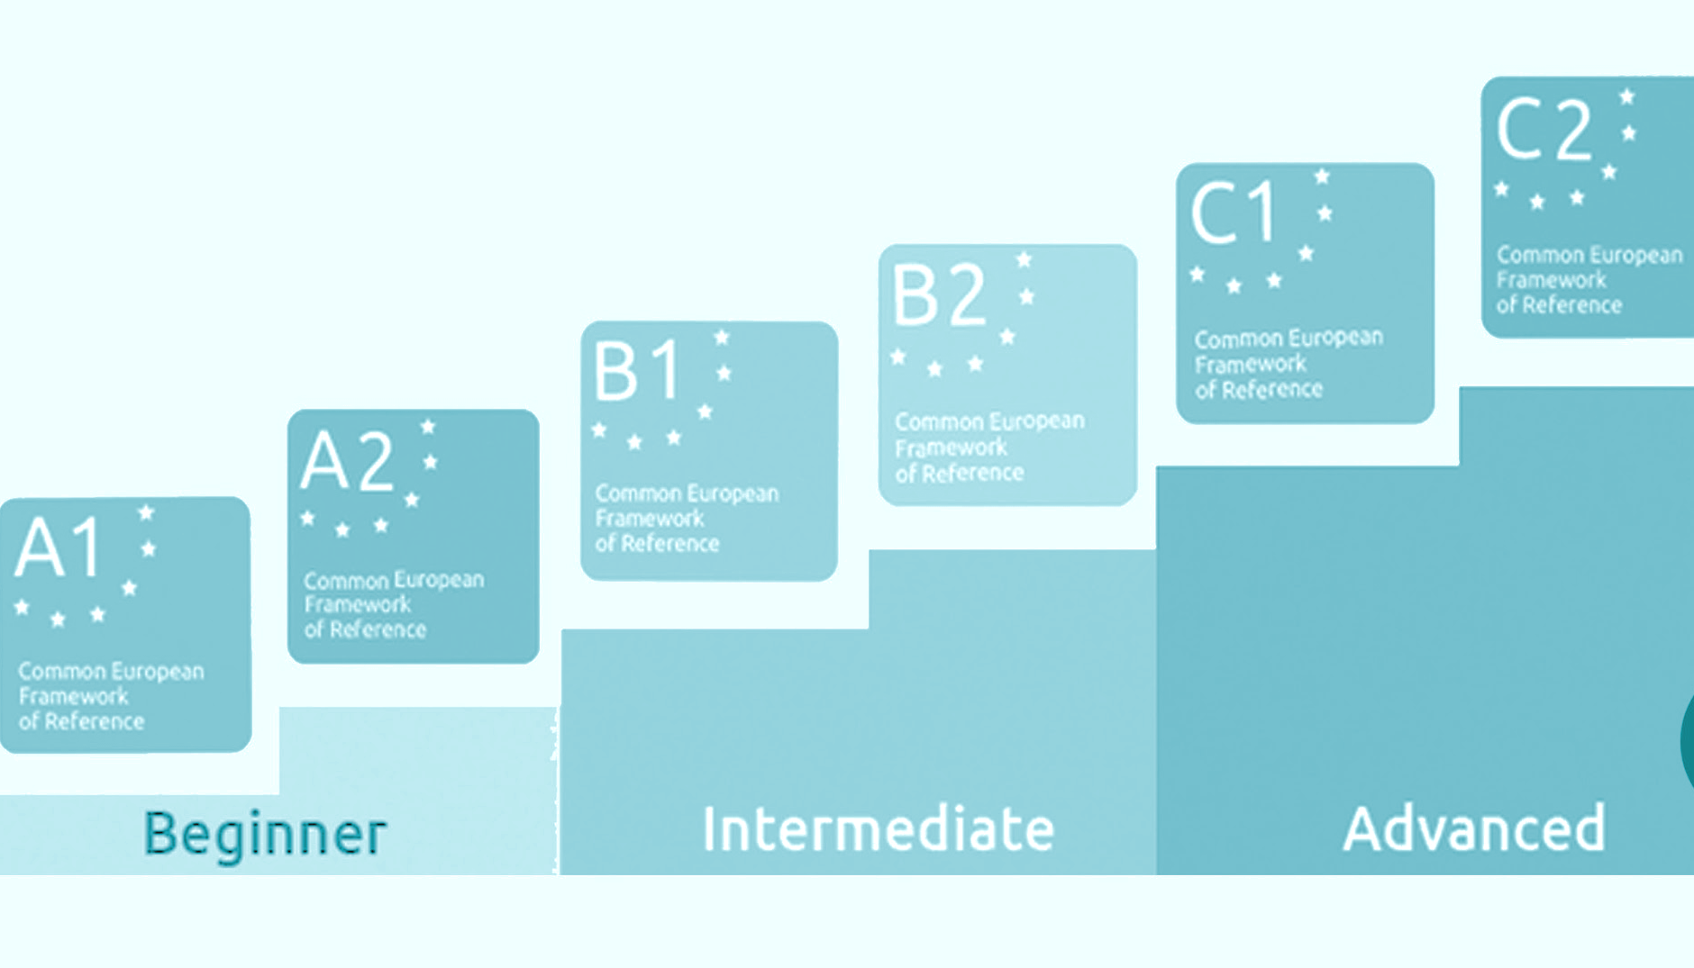
Target users
Notes:
Goal - Chinese speakers learning English in an immersive environment; approach this in a research angle
Target user - CEFR level A2 - B1;
Potential testers -
Chinese Tourists on campus;
Local Chinese community
Chinese international students who are new to the country

Slide 28
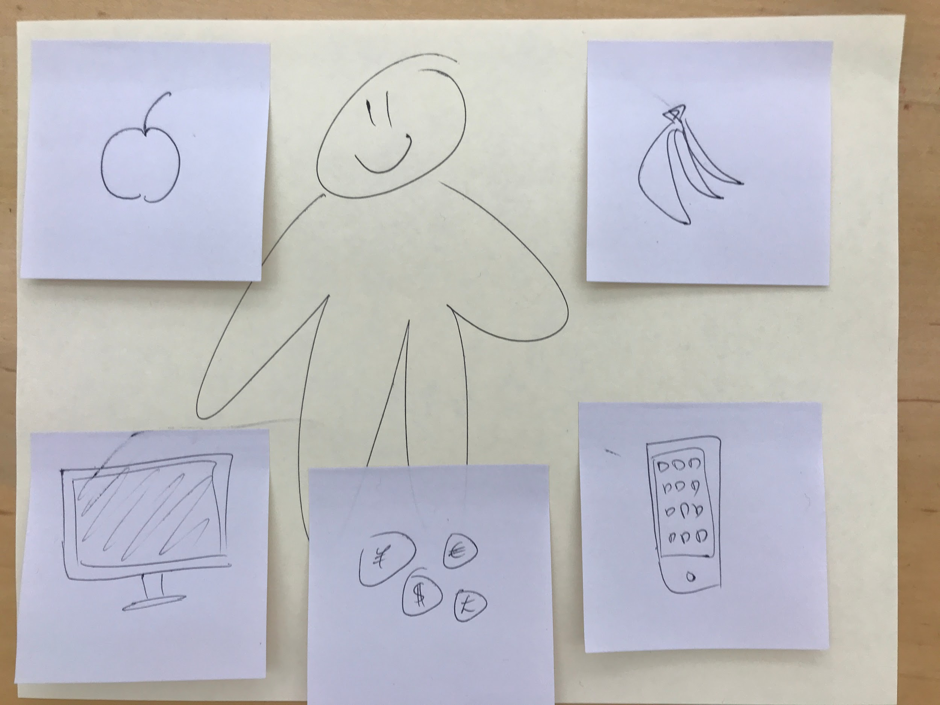
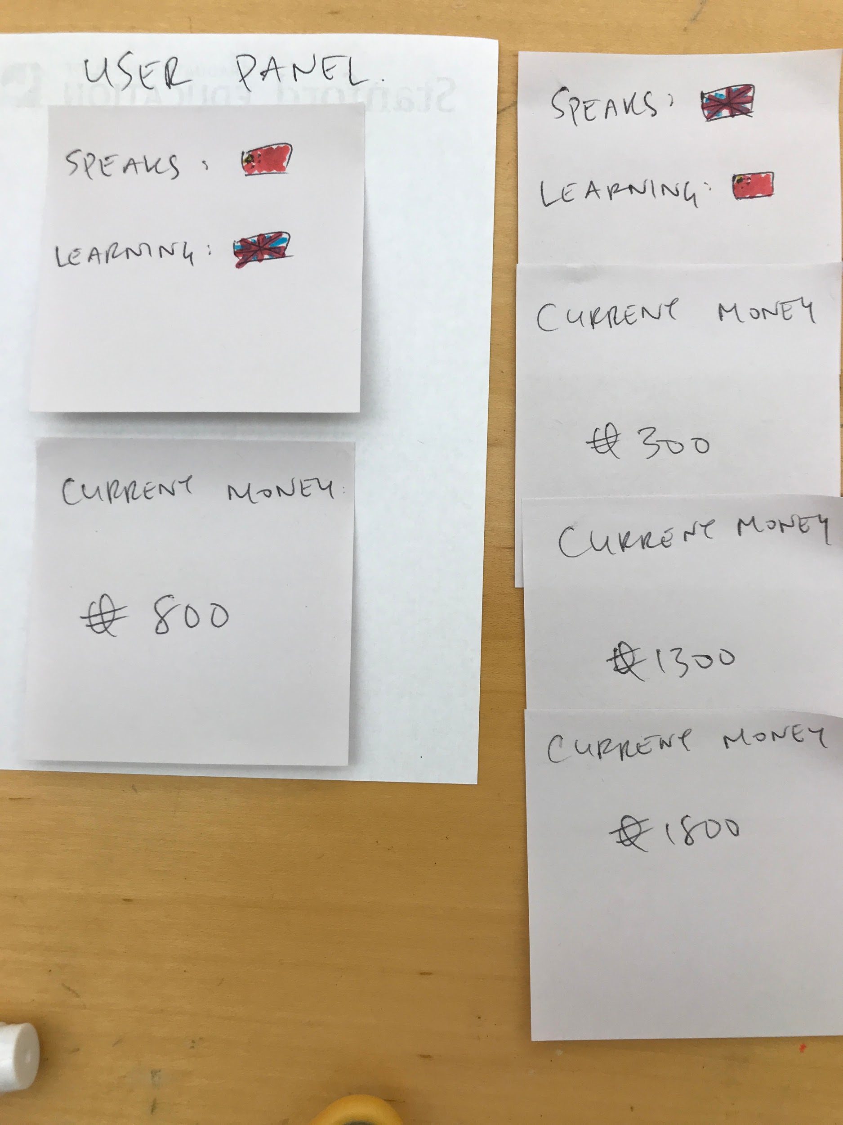
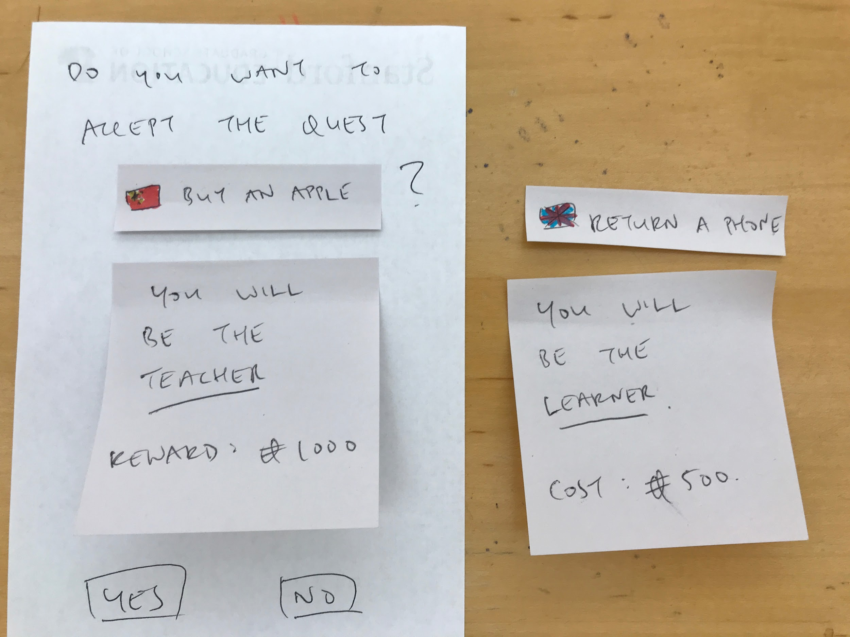
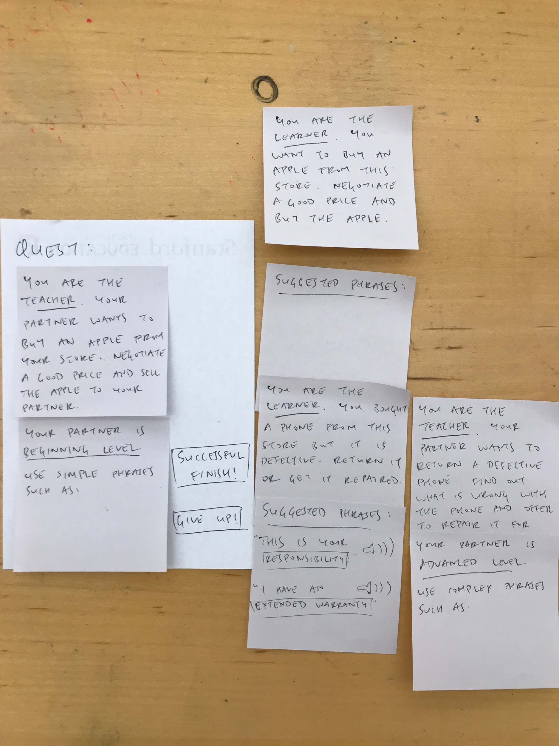
Before
Notes:
Previous paper prototype

Slide 29
Scenario #1
Multivrse
A visit to the mechanic
START

Slide 30
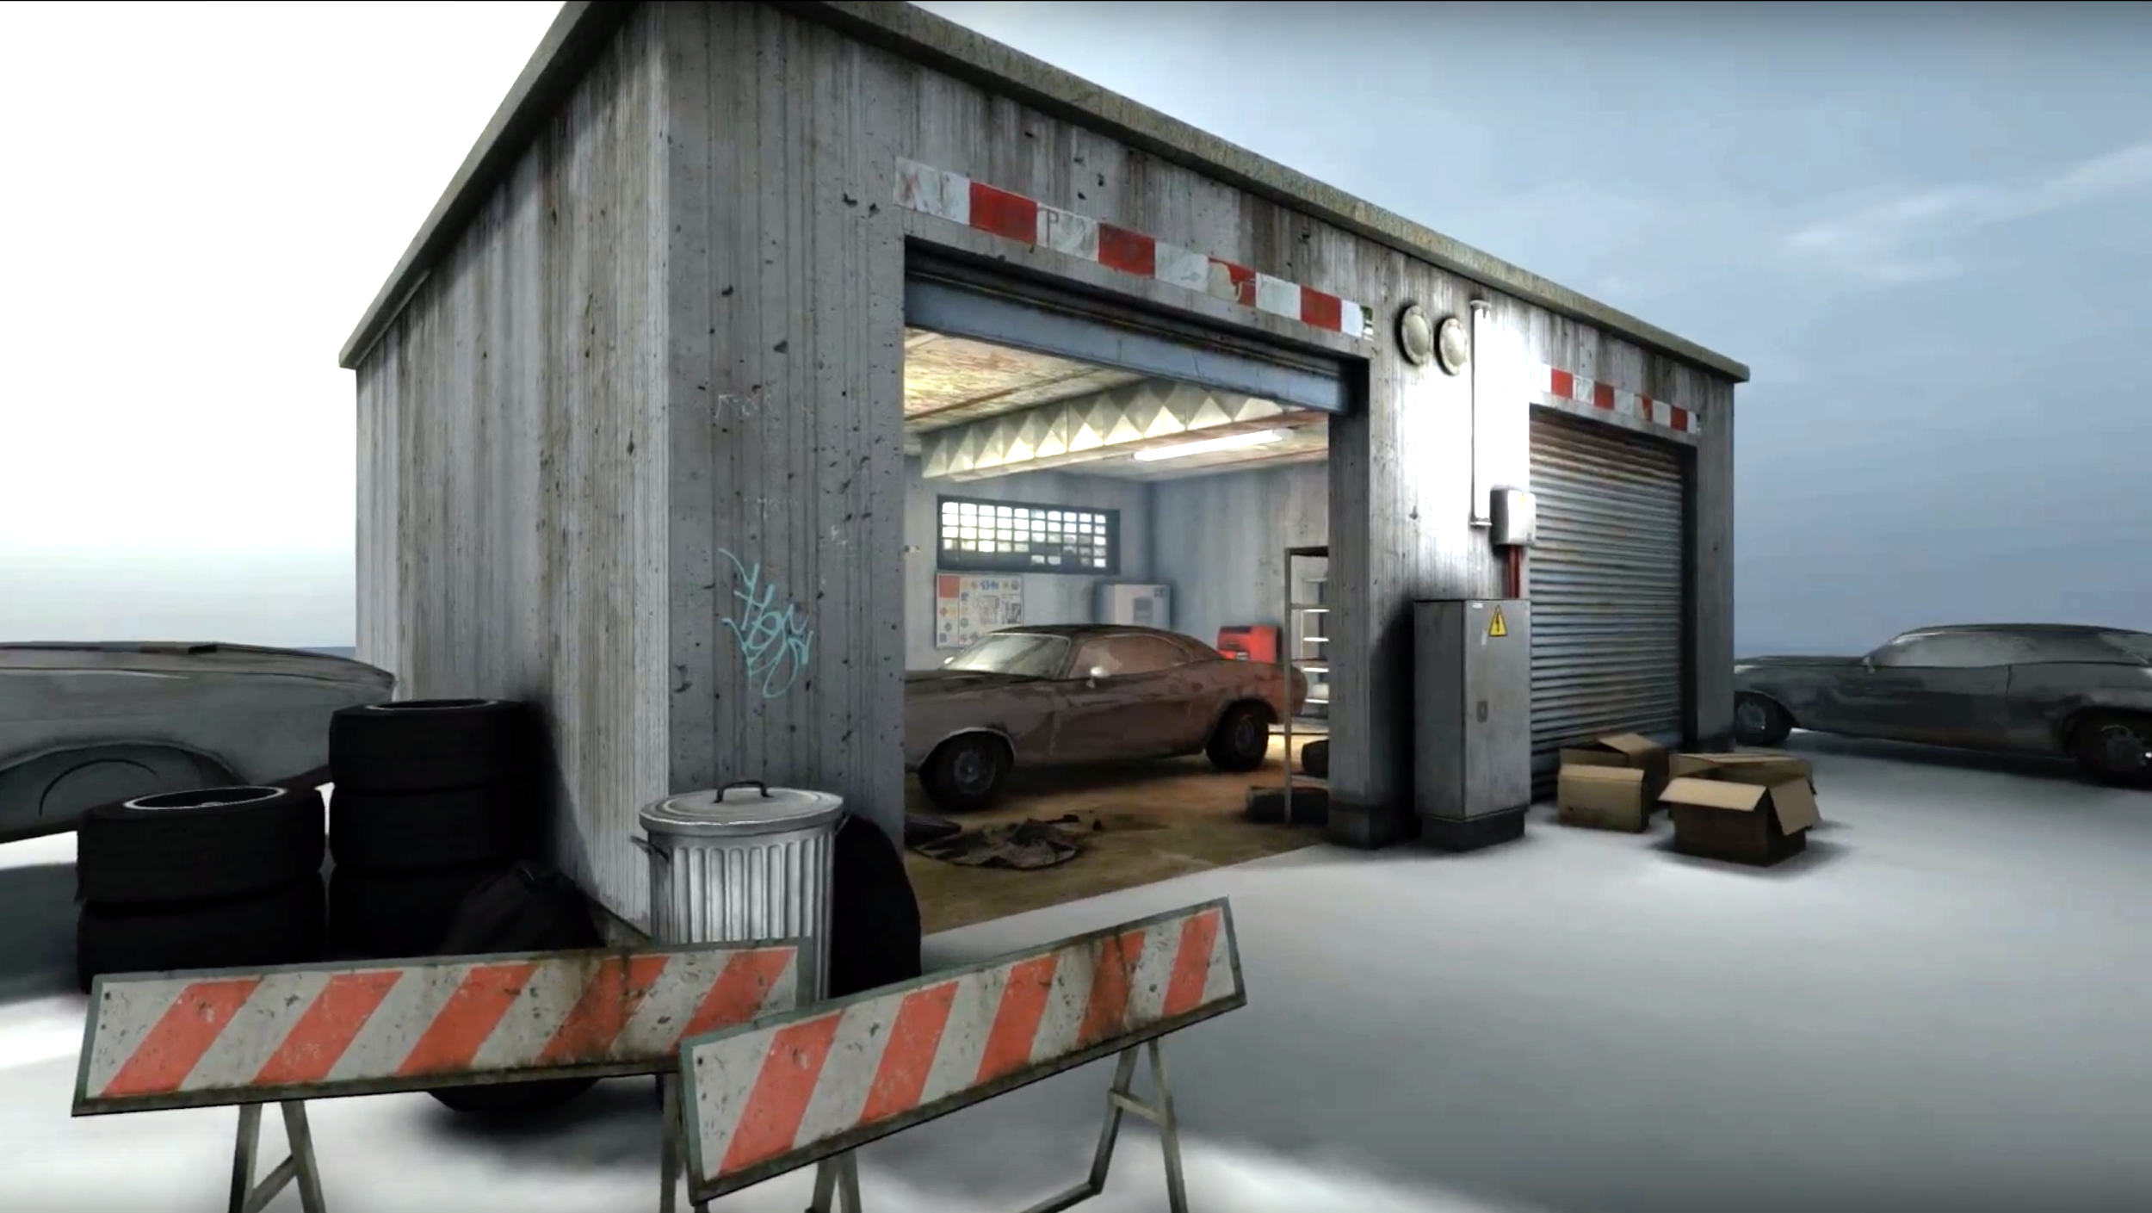
你邻居的车在车库里起火了，被拖送去了维修厂。虽然他在美国生活了很多年， 你的邻居并不会说英语。你决定帮助他，载他去维修厂并替他跟机修工用英文沟通。为了方便你沟通，邻居在一张纸条上写了他所以记得可能跟这次事故有关的信息。
你的目的是帮助你的邻居与维修工约定好修理费和维修时间，并咨询维修期间他能得到什么样交通替代以便日常生活及上下班。
继续
Notes:
We

Slide 31

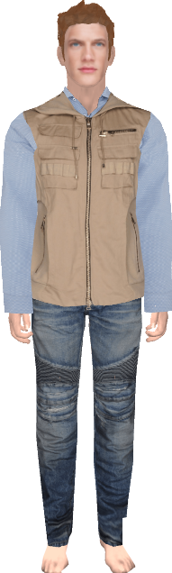

Hi there. How can I help you?
字典
离开

Slide 32
字典
离开
我车子信息：
一周前，我车子的风扇开始有奇怪的噪音。一般噪音出现一分钟左右，“检查引擎”的提示灯会出现。
踩油门时，引擎过热的等也会亮。
我车子之前没有电池放了两个月。我自己装的电池。在那都好好的。
我在车50，000里程时候送去经销商那里保养，换了水泵。一般大家说换了水泵时候也要换恒温调节器。我经销商处理的保养，我不是很清楚他们换了没换恒温调节器。
我的车上了保险。
Notes:
Approach
Show the user interface, play an introduction video and show them their task description
Tell the user they are either communication with an AI or a human agent

Slide 33
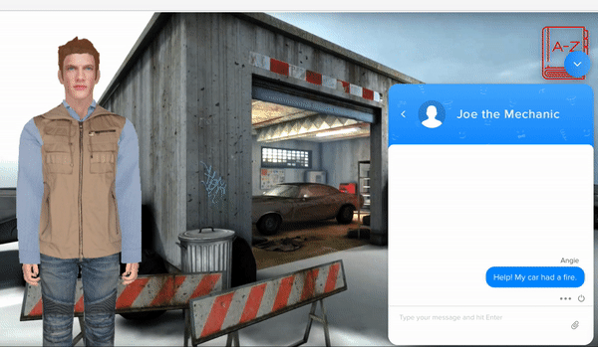
Wizard of oz Prototype
Check it out: http://angelic.ai/multivrse.html
Notes:
In the idea situation, we would Wizard of Oz in both conditions and give responses using Google text-to-speech.
For now we have not seamlessly integrated text-to-speech to the system so we used both chatbot interface and direct role-plays to test the scripts and scenario we have in mind.
The choice of the mechanic and autoshop was inspired by our needfinding, where one participant mentioned he had trouble communicating with a mechanic.
We also asked language learners and some of our previous participants about situations where they find difficult to navigate. It seems that they had trouble communicating in restaurants, over the phone, and situations where there involve technical terms.
Prototyping Tools
What did you use? - How did the tool helped? (what was easy) - How did the tool did not help? (what was hard)
Chatbot
Limitations/tradeoffs of the current prototype (what was left out of the prototype & why)
Text-to-speach

Slide 34

Insights
User spoke aloud the text from "Joe the Mechanic"
Errors introduced by speech detection were very frustrating. Sometimes the learner was not sure if the error was theirs, or a tech failure.
"I know what happened, but it is hard to convey the message with my limited vocabulary, it felt a little bit like a charades game"
"A car ‘Hood’ is an American thing, a colloquial term, even if I do know the word for the hood [in French], it might actually mean like a coat hood."
“I usually check in to make sure the person understand what I am saying, or If they are looking confused” -> Facial expressions are important
Notes:
The self-combustion seems unlikely and the car is probably not going to be repairable.
Script Piloting feedback:
The self-combustion seems unlikely
Errors introduced by Speech detection were very frustrating. Sometimes the learner was not sure if the error was theirs, or a tech failure.
“Speech was easier because I did not have to worry about spelling. Depending on gender, some words are spelled differently but they mostly sound the same” - Native English Speaker Learning French

Slide 35
Progress
Prep work:
Pilot tested our scripts and user task
Getting ready to setup the experiment using VR
Next steps:
More detailed data collection and analysis set up
Pilot the experience with VR, revised script and Google Text-to-Speech with target users
Notes:
Besides coming up with the experiment design and basic testing interface, here’s some other progress and things we’ve learned
The self-combustion seems unlikely and the car is probably not going to be repairable.
- User spoke aloud the text from "Joe the Mechanic"
- I looked up gender of words more when typing than speaking
- "I know what happened, but It is hard to convey the message with my limited vocabulary, it felt a little bit like a charades game"
- "hood is an American thing, a colloquial even if I do know the word for the hood, it might actually mean like a coat hood"
- I usually checking in to make sure the person understand what I am saying, or If they are looking confused” -> Facial expressions are important

